Slide 1


Credit Card Early
Risk Detection
System
Early Warning System for Credit Card Delinquency using Machine Learning + Behavioral Flags
by Bikash Bora
Gauhati University

Slide 2
Problem Statement
Late Detection
Subtle Signals
Solution Need
Banks detect risk too late (after DPD increases)
Subtle early signals exist but are rarely tracked
Need a lightweight, explainable model to identify early delinquency risk

Slide 3
Objectives
03
04
01
02
Detect early warning signs before default
Classify customers into Low/Medium/High risk
Provide flags + action recommendations
Offer downloadable reports (Excel + PDF)
05
Build a UI for easy readability

Slide 4
Dataset Overview
Comprehensive customer transaction data with behavioral indicators for risk assessment
Feature
Origin of the creative idea
Origin of the creative idea
Credit Limit
Maximum credit allowance
Numeric
Utilisation %
Current usage percentage
Numeric
DPD (Days Past Due)
Days overdue on payments
Numeric
Monthly Spend Change
Month-over-month spending variation
Numeric
Min Due Flag
Minimum payment behavior indicator
Binary
Merchant Mix Index
Diversity of merchant categories
Numeric
Cash Withdrawal Frequency
ATM cash advance frequency
Numeric
Target Variable
30+ Delinquent status
Binary

Slide 5







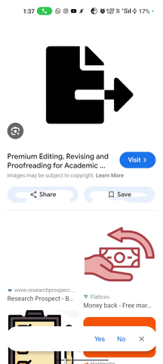
Solution Architecture
Data
ingestion
CSV/XLSX
Preprocessing
Standardization
Behaviour
flags
engine
Random
Forest
model
Risk scoring
segmentation
Report
generation
Exel+PDF
Streamlit UI

Slide 6


Behavioral Risk Flags (Rule-Based)
04 DPD Early Warning
01 High Utilisation Flag
(15 days)
(>80%)
05 Roll Rate Risk
02 Minimum Due Behavior Flag
(30 / 60 DPD)
(spend drop)
06 Cash Withdrawal Spike
03 Essential Spend Spike Flag

Slide 7

Machine Learning Model
Rendom Forest
Classifier
Balanced class
weighting
1
2
Risk
segmentation
Probability
score output
4
3
Low:3-0.33
Medium:0.33-0.66
High:0.66-1

Slide 8
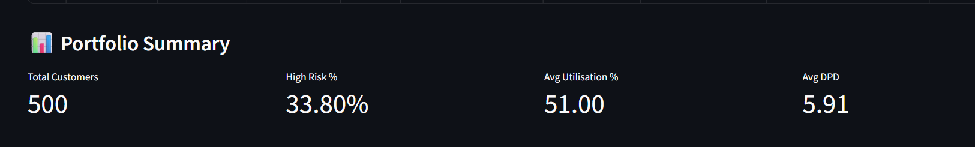
Portfolio Summary (KPIs)
for 500 customers
Data Quality
Risk Coverage
Response Time
  Real-time transaction processing
  Automated data validation
  Behavioral pattern recognition
  Multi-dimensional risk assessment
  Predictive flag generation
  Actionable insights delivery
  Real-time risk evaluation
  Automated flag triggers
  Immediate alert distribution

Slide 9


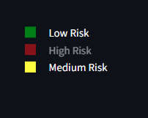
Visual Dashboards
for 500 customers
Portfolio Risk Score
Streamlit UI Features
Real-time gauge showing overall portfolio health with color-coded risk levels
Interactive dashboard with drag-drop file upload and instant risk visualization
Risk Distribution

Slide 10
Recommended Actions
High Risk
Proactive outreach, payment plan, EMI options
1
Medium Risk
2
Reminder SMS + nudges
Low Risk
3
No action, monitor

Slide 11
Outputs Generated
Color-coded Excel risk file
Color-coded Excel risk file
Customer segmentation with risk level color coding for quick visual identification of high-risk accounts
Customer segmentation with risk level color coding for quick visual identification of high-risk accounts

Slide 12
UI Features (Streamlit)
01
02
03
04
05
05
PDF report generator
Easy-to-understand visualizations
File upload
Data preview
Risk prediction
Excel export

Slide 13



System Scalability Plan
Batch scoring pipeline
Implement high-throughput batch processing system for large-scale model inference
Cloud deployment (AWS/Azure)
Migrate infrastructure to scalable cloud platform with auto-scaling capabilities
Drift monitoring
Implement continuous performance monitoring and alerting system
1
2
3
4
5
Weekly retraining with new data
Establish automated data pipeline and model retraining schedule
Integration with CRM/SMS systems
Develop API connectors for seamless integration with business systems

Slide 14





Future Enhancements
Fraud anomaly detection
Integrate unsupervised learning models to flag suspicious transactions and behavioral patterns
SHAP explainability
Implement SHAP values to provide transparent model explanations and feature importance rankings for all predictions
Real-time scoring API
Develop low-latency API endpoint for instant model predictions with sub-100ms response times
SMS bot for auto-reminders
Automate customer engagement through personalized SMS notifications and payment reminders

Slide 15

THANK YOU

